Slide 1

课时练习
模块七 第二章 第二节

Slide 2
一、翻译下列词组。
1. 两片面包 _____________________________
2. 把……放一起 ____________________________
3. 随便吃/喝…… ____________________________
4. 熟能生巧。 ___________________________
two pieces of bread
put … together
help yourself/yourselves to …
Practice makes perfect.

Slide 3
二、根据语境、音标或所给单词的提示完成句子， 每空一词。
1. Boys and girls, help___________to some grapes.
2. In Turkey, it’s___________(polite) to turn down a cup of tea from the host.
3. I was only ill once and that came of eating an unripe(未成熟的)__________/peə(r)/.
yourselves
impolite
pear

Slide 4
二、根据语境、音标或所给单词的提示完成句子， 每空一词。
4. The new navy museum in Qingdao houses more than 4,000__________(piece) of cultural relics(文化遗产) and nearly 100 artworks.
5. To be a good moviegoer, you shouldn’t eat or drink__________(noisy) at the movie theater.
pieces
noisily

Slide 5
三、单项选择。
( )1. —Would you mind if I open the window?
—__________. It’s hot in the room.
A. Of course not B. Don’t do that
C. You’re welcome
A

Slide 6
三、单项选择。
( )2. —China is over 5,000 years old. It’s one of _____countries in the world.
—Yes. It has a much_____history than the US.
A. the oldest; long B. the oldest; longer
C. the old; longest
B

Slide 7
三、单项选择。
( )3. Jack is the________football player in our school. He often wins first place.
A. good B. better C. best
C

Slide 8
三、单项选择。
( )4. Please don’t put so many books______the shelf. It’s not strong enough to hold them.
A. away B. on C. over
B

Slide 9
三、单项选择。
( )5. —If you keep speaking English every day, you’ll be better at it.
—I agree. ________.
A. Of course B. Never mind
C. Practice makes perfect
C

Slide 10
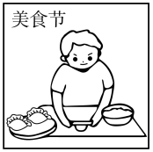
四、看图写话。
1. now, for
The boy is making dumplings for the food festival now.

Slide 11
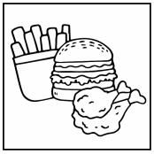
四、看图写话。
2. bad, for
Junk food is bad for (people’s) health.

Slide 12
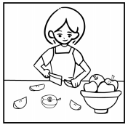
四、看图写话。
3. cut … into
The woman/She cut the apple into (small) pieces.

Slide 13
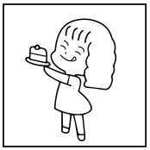
四、看图写话。
4. think, delicious
The girl/She thinks (that) the cake tastes/is delicious.

Slide 14
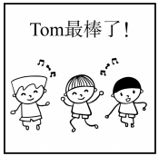
四、看图写话。
5. of, dance, best
Of the three boys, Tom dances (the) best./
Tom dances (the) best of the three boys.

Slide 15


